Slide 1
Rethinking Transportation Anders Bylund 2019-02-14 @ Mälardalsrådet
siemens.com
Unrestricted © Siemens AG 2019

Slide 2
Global megatrends lead to increased traffic volumes
Cities will grow
Travel distance increases
km / lifetime
By 2050: Additional 2.5 Billion people will live in cities worldwide
Since 1965: The distance travelled per person has increased by 70% in the UK.
United Nations, World Urbanization Prospects: The 2018 Revision
Department of Transport, England Transport stats 1965-2015

Slide 3
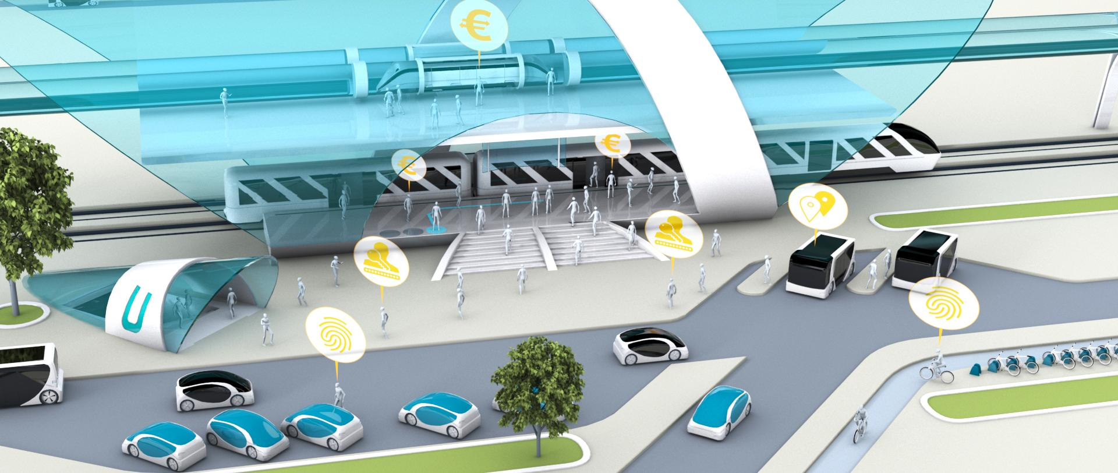
Rail
IT-based capacity maximization
Passenger Experience
Intermodality
Autonomous Driving
Mobility as a Service
Mobility on Demand
Demand Responsive Transport
Road
E-Mobility
Sharing Economy

Slide 4





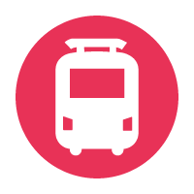
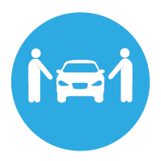

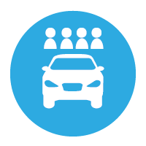



The travel behaviour of passengers in today´s interconnected and data driven mobility era has changed
One single interface
Bike Sharing
Bike&Ride
Car
Taxi
Public Transport
Flight
Walk
Bike
Long distance bus
Car Sharing
Carpooling
Park&Ride

Slide 5
Public Transport Operators are now facing competition and need to deliver digital, reliable, individual and affordable solutions …
1000101101101010011011001001101010110110001101
Digital Experience
100010110110101010101101011011010101011011010100101001011010011011001001101010110110001101
Last Mile Solution
010110010110101011100101101101010101001011011010100101101001010110101101
010110110101010110110101010101010010110110101011001010101010110101111010001001001101
Operator
Reliability
Affordable Prices
… to remain part of the transportation chain

Slide 6
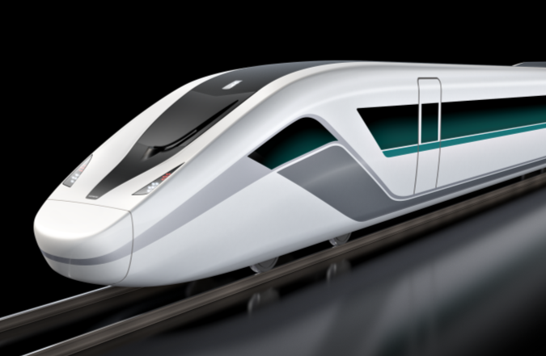
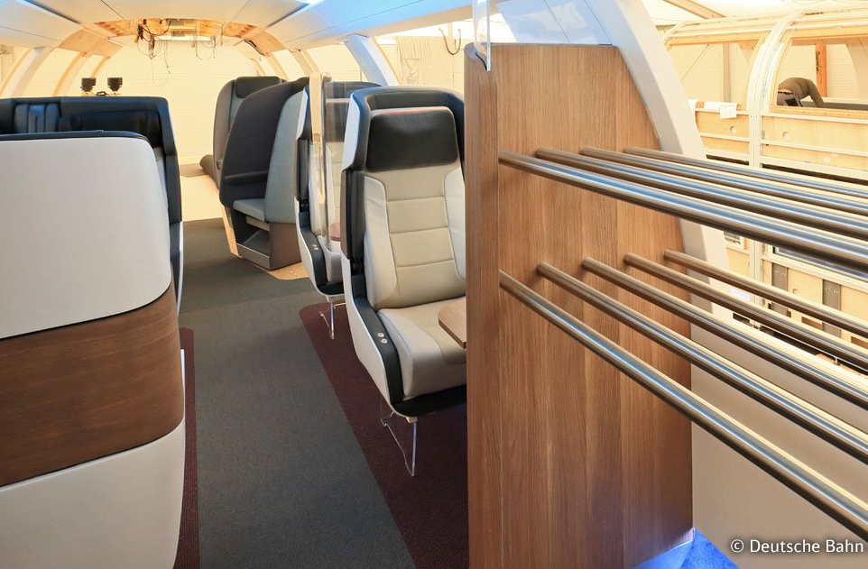
What does this mean for railway vehicles…
Smart Seat
© DB AG
… digital ride experience and enhanced passenger information systems

Slide 7
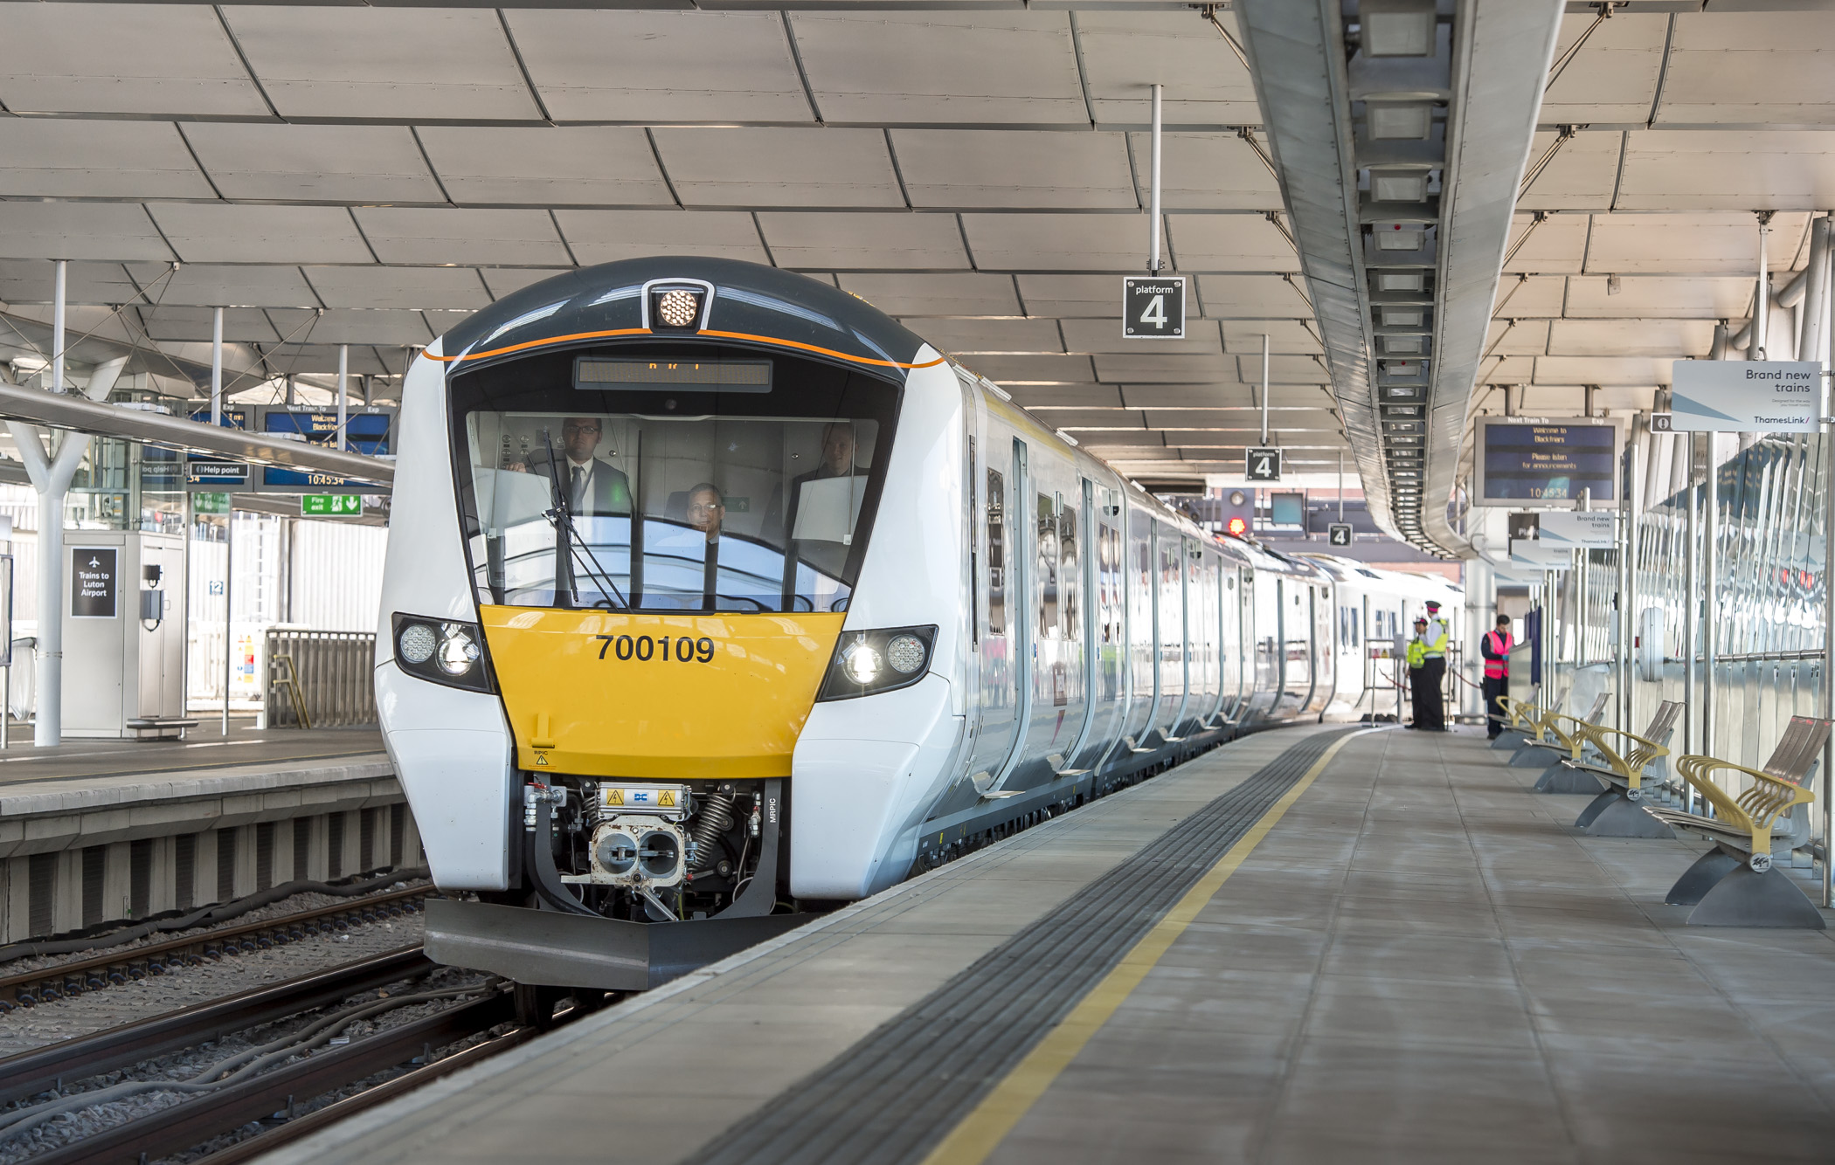
What does this mean for operations …
… they become automatic and demand responsive

Slide 8
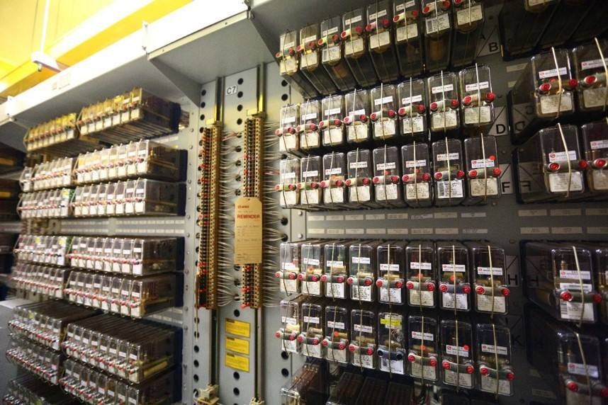
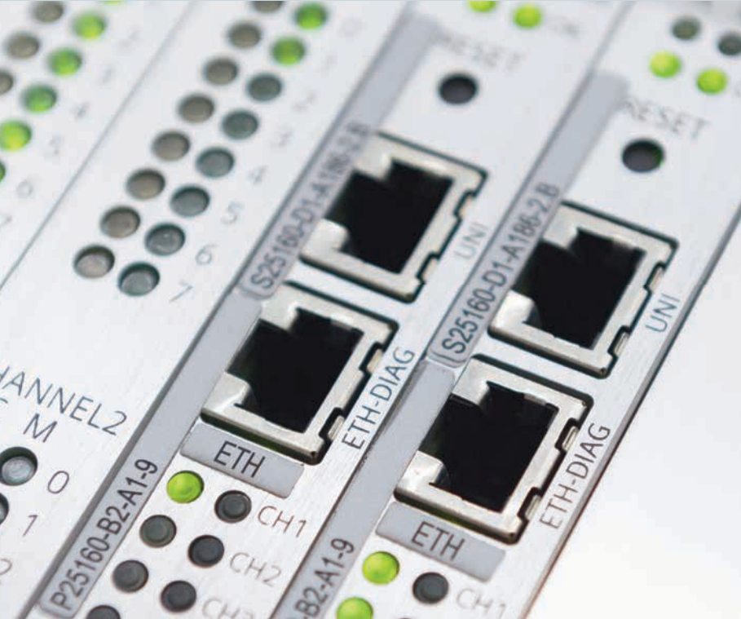
What does this mean for infrastructure …
Relay
IP based
© Land Transport Guru
… less cabling and hardware

Slide 9
MindSphere The open IoT operating system by Siemens will be the platform for future applications and services
Road
Operation
Connec-tivity
Rail
Rolling
Stock
Main-tenance
IT Security
MindSphere
01
00
11
10
01
00
11
10
00
10
11
01
10
01
01
11
10
01
01
11
10
01
01
11
01
10
01
01
00
10
01
01
00
10
01
11
10
11
10
01
01
11
10
01
01
11
10
01
01
11
10
01
01
11
01
00
11
10
10
01
01
00
01
00
11
10

Slide 10
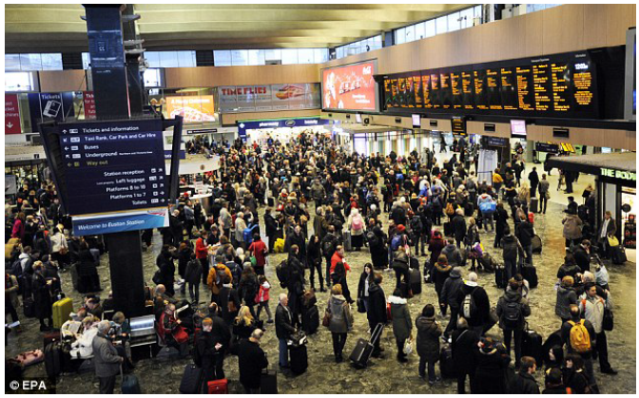
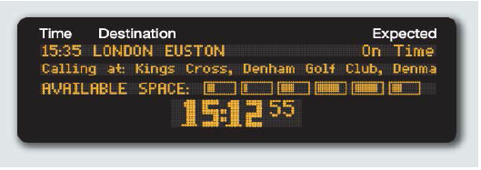
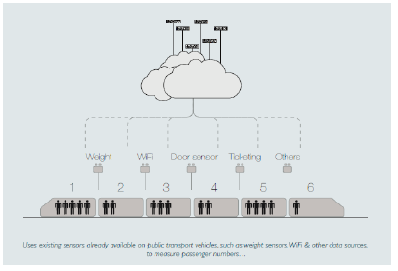
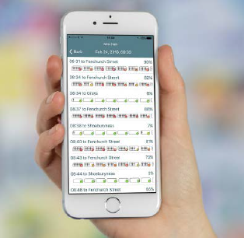
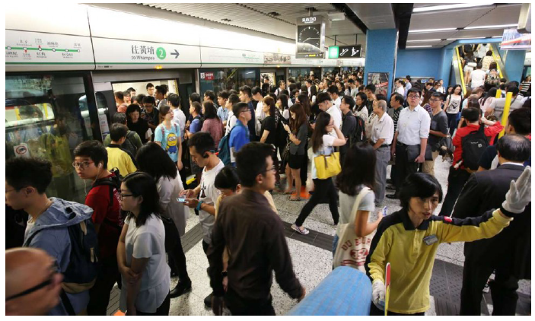
Example: Increase Throughput and Customer Experience by load prediction in the Digital Station

Slide 11
New strategic priorities, New Business models and eco-system
Guaranteed
Availability
Optimized Capacity Profile
Digital Passenger Experience

Slide 12
Thank you.
siemens.com
Unrestricted © Siemens AG 2016

