Slide 1
Trafik- och Transport-perspektiv Mälardalsrådet 14/2 2019 Lars Wiigh, IBM

Slide 2


Slide 3
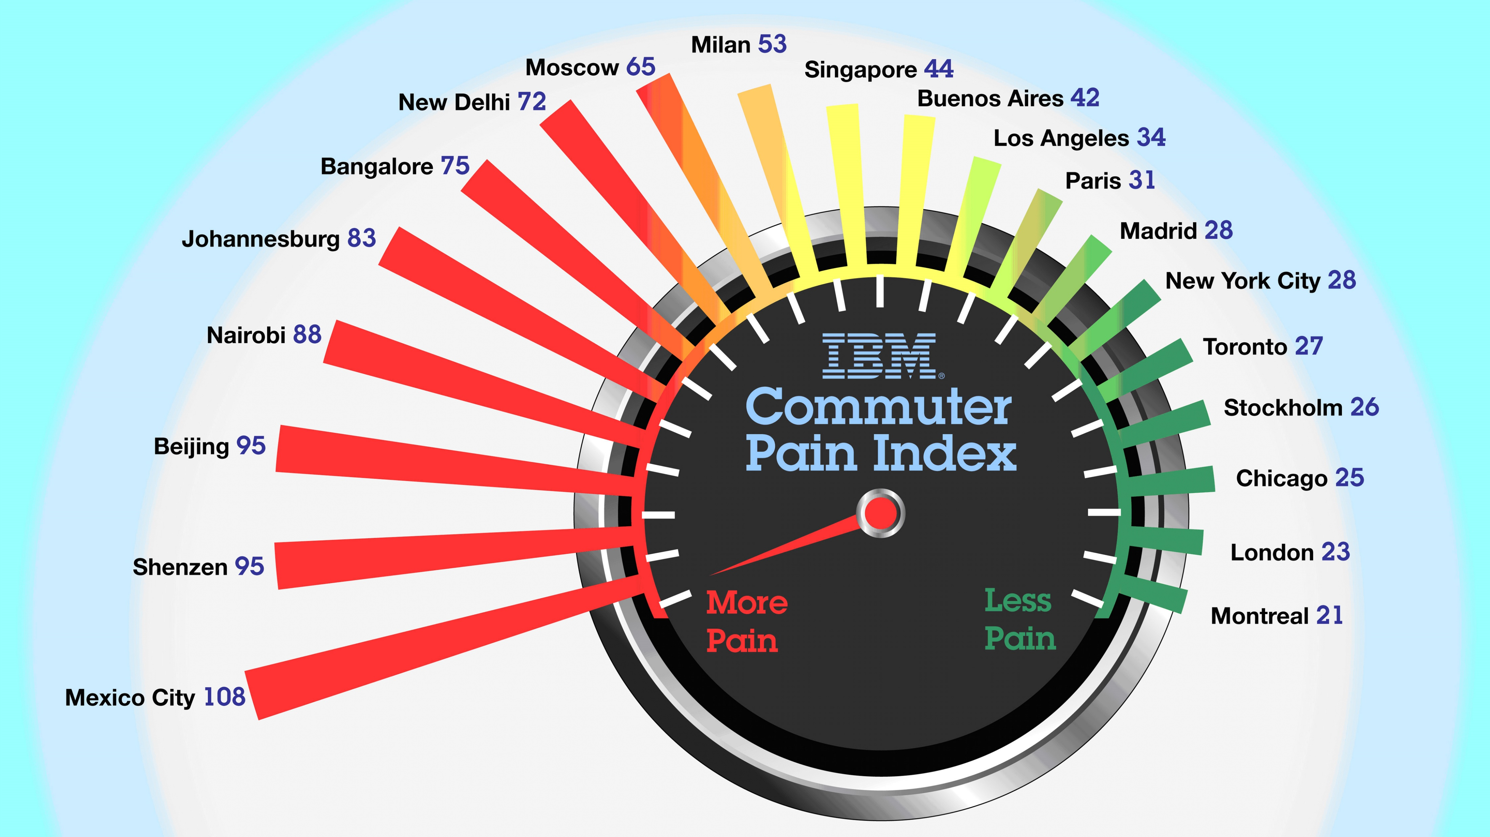

Slide 4
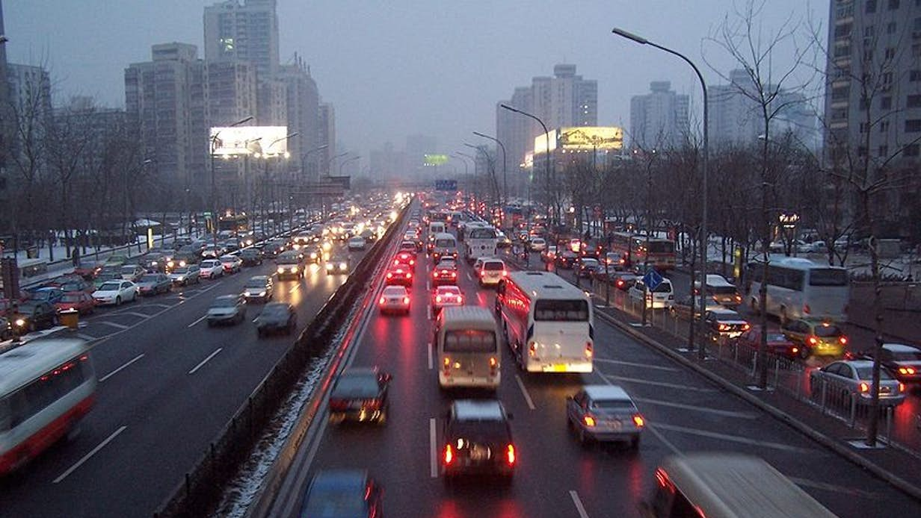

Slide 5
Perspektiv och alternativa ansatser
Totaloptimering
Låt många blommor blomma
Demand vs Supply
En multimodal hybrid

Slide 6
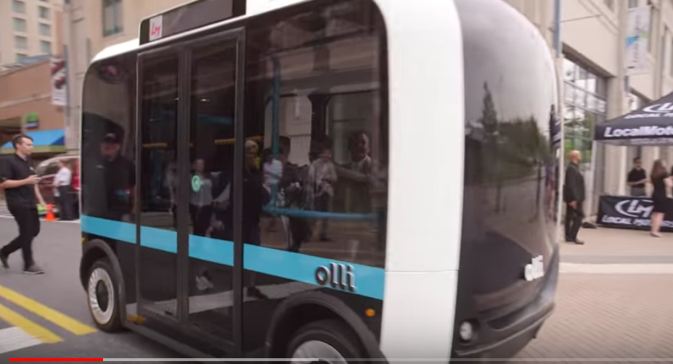
Olli – the autonomous bus https://www.youtube.com/watch?v=K564rXrlZbc

Slide 7
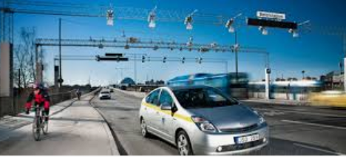
Stockholm Trängselskatt

Slide 8
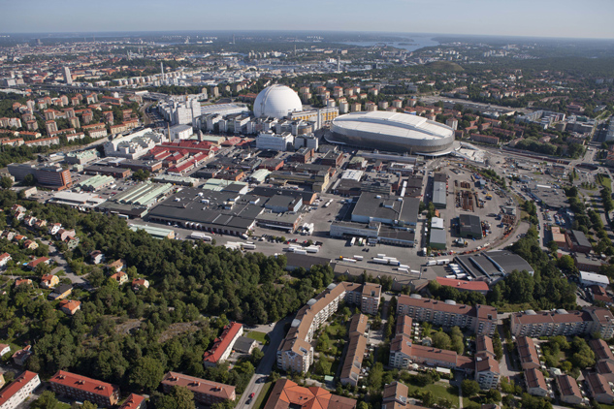

Slakthusområdet - Stockholm
EU H2020
GrowSmarter Project
City of Stockholm and IBM
Notes:
Här skriver du in dina anteckningar! Detta fält visas inte för publiken.

Slide 9
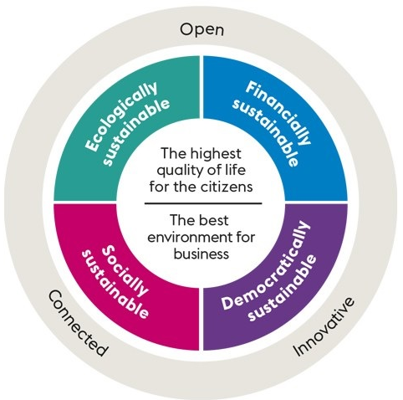

Strategy for a smart and connected city
Notes:
Här skriver du in dina anteckningar! Detta fält visas inte för publiken.

Slide 10

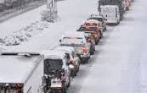
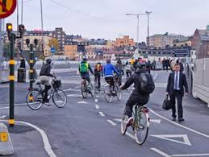
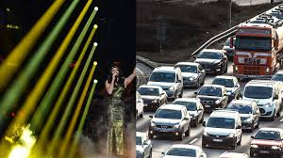
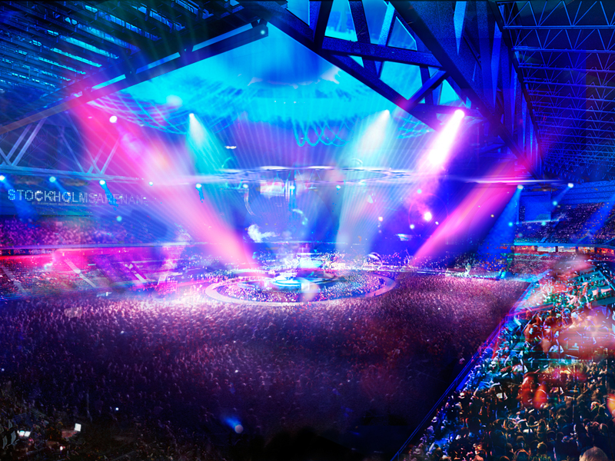
Measure, Data, Analyze, Action, Impact
Notes:
Här skriver du in dina anteckningar! Detta fält visas inte för publiken.

Slide 11
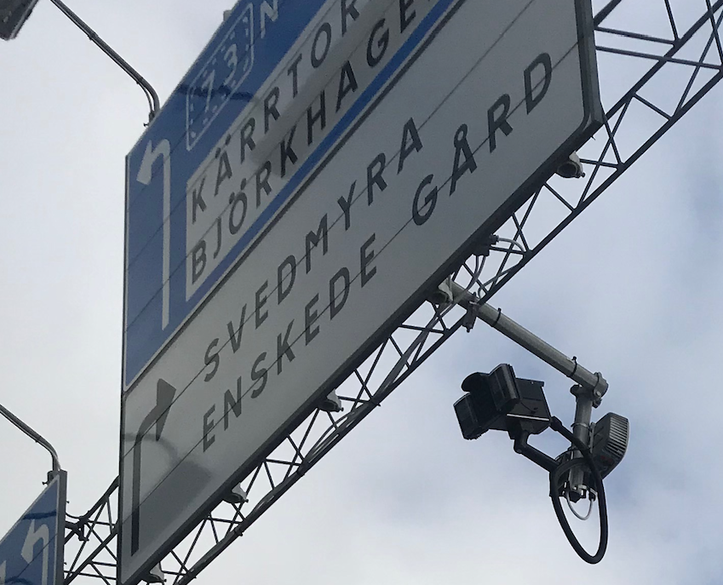
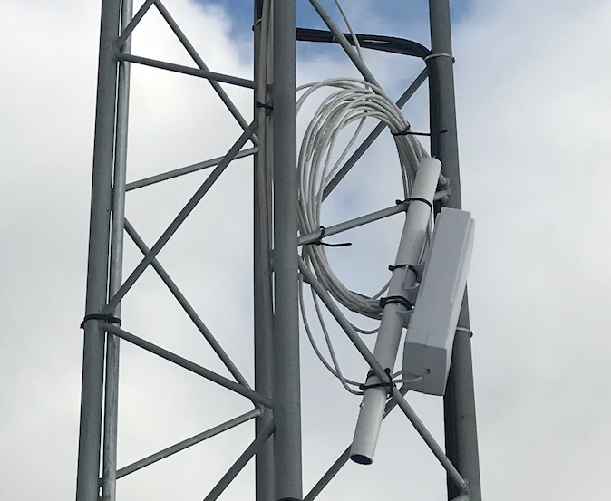




Datasources
Camera sensors catch up on passing vehicles and read the registration number. This is stored anonumously, together with information about the vehicle.
Sensors capture signals from mobile devices looking for available Wi-Fi networks. The phone’s identity is stored anonymously along with signal strength.
Current weather observations from Bromma are continously stored together with 3- and 10-day forecasts for the area.
Notes:
Här skriver du in dina anteckningar! Detta fält visas inte för publiken.

Slide 12


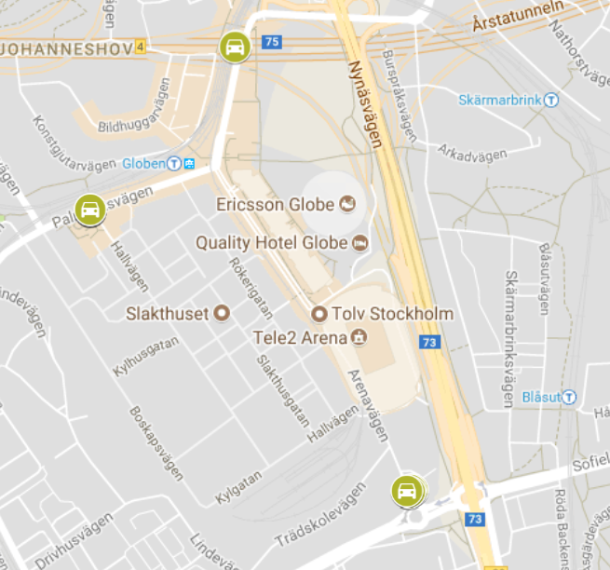
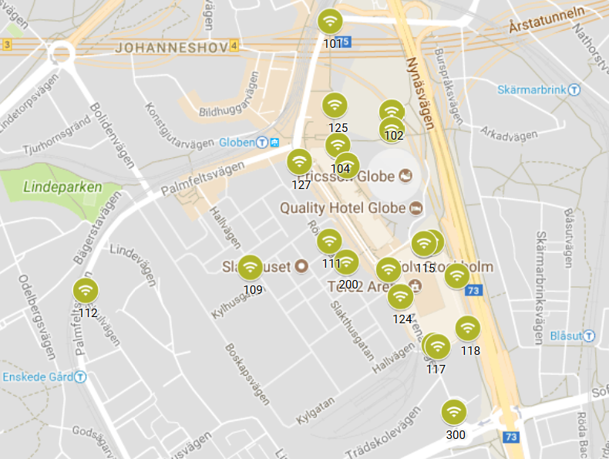
Sensor network
Vehicles, 10 sensors
Pedestrians, 23 sensors
Notes:
Här skriver du in dina anteckningar! Detta fält visas inte för publiken.

Slide 13
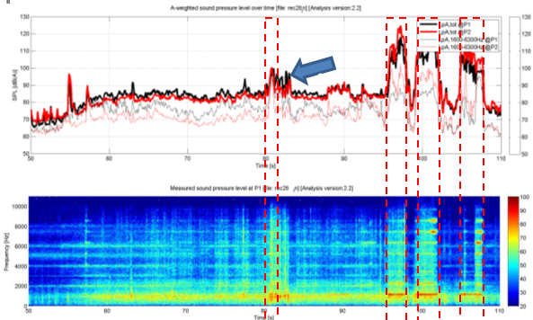

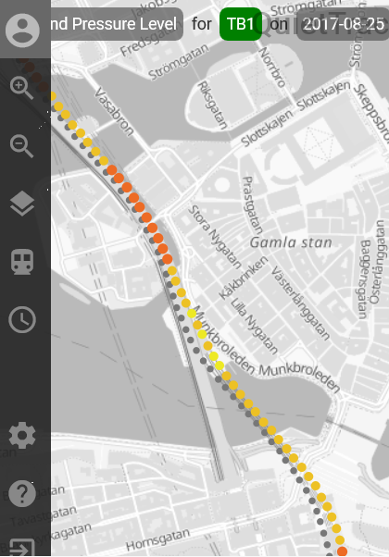

Acoustics Analytics with IoT Help SL Identify and Reduce Track Wear & Tear and Noise
Challenge
Reduce noise and wear & tear in railway tracks of Stockholm's Rail and Metro
Track maintenance was a major challenge for Storstockholms Lokaltrafik (SL), Stockholm’s rail and metro operator
Measuring the condition of the tracks is a manual process performed periodically on closed tracks
Dependent on engine drivers to report track damage that require urgent repair
Lack of good data leads to difficulties in planning maintenance, handling problems, and addressing noise complaints from the general public
Solution
IBM Quiet Track Monitoring System continuously monitors the condition of railway tracks using microphones and other sensors mounted on seven metro trains
Calculates and presents a number of parameters for each section of the track
The central system is running in IBM Cloud and contains components to store and present track data, identify need for track maintenance and generate automatic alerts for urgent problems
End users at railway operators or maintenance companies use the solution to monitor the condition of the tracks.
Benefits
Track data, real-time insight into track condition and alerts available to SL and subcontractors
Reduced cost for track maintenance through automatic analytics and targeted investments
Reduced risk for damage on track and wheels due to severe wear in curves or wheel slip
Extended lifetime of tracks
Reduced cost for noise reduction activities and better handling of complaints from general public
Reduced risk for delays and better flow in traffic

Slide 14


Madrid Intelligent – the MiNT Platform Enables a 21st Century City
Challenge
Managing a Complex City of 3.1 mn people
1.7 mn vehicles, 287,000 fees invoiced, 250,000 streetlights, 835 public buildings
Need to serve citizens with collaboration, transparency, and service improvement
Goal to work with businesses and 3rd party service providers to leverage use of mobile, voice, data & IoT
Enable the payment for service by 3rd party businesses (e.g., street cleaning) to move from pay-per-activity to payment based on SLAs.
Solution
MiNT Platform to support new application development, legacy app migration, app maintenance
SLAs and KPIs to improve services efficiency and quality and reduce costs
Enables City operations and City Council strategy to align around IT strategy and implementation that supports citizens and businesses
Supports services for mobility, construction, roadwork, waste control, environmental protection, historical and park preservation
Foundation based on IBM IOC, Maximo Assets, Bluemix and Analytics
Benefits
Cross Traceability for all activities made in the city
Unique inventory of information available for all stakeholders
Exhaustive knowledge of what is happening into the City
All services measured to optimize costs and enable payment of 3rd parties through SLAs

Slide 15
System Context – Data Flow
Traffic Flow
Surveillance
ETL / Web Service / FTP
Traffic Flow
Prediction
Traffic Management
Console System
Traffic Incident
Management
TODM
Traffic Information
Service System
VMS Control
System
Road Infrastructure
Traffic Flow
Device
Traffic Event
Road Asset
Management
Traffic Analysis
& Optimization System
Weather
Information
Transportation Operational Data Model (TODM) integrates real time or near real time operational data from/for various operational system.
Event Plan
…

Slide 16
Transportation Operational Data Model
Transportation Operational Data Model is a reference data model to integrate real time or near real time operational data from/for various operational system. It could be used to support integrated transportation operation system and traffic information service system, provide features including real time and predictive traffic information monitoring and sharing, transportation management collaboration and traffic analysis.
TODM asset provides data model specification to accelerates delivery and design projects.:
Provides data model as start point to understand transportation operational business information structures and rules, enable unambiguous communication of this understanding.
Data model including specification and model files provide a practical example following GS Method for delivery team, easy to customize according to specific requirements.
Data model design referred transportation data standards including DATEX2, adaptive for data exchange
Data model referred to real client projects system including Singapore LTA

Slide 17
Solution Context - Business Architecture
Transportation Operational Data Model is a reference data model of Traffic Information Management System.

